Slide 1
Vision to Visualisation: Using GitHub Copilot for Azure, Python, and Diagrams
Gosia Borzecka | Marcel Lupo

Slide 2
Problem
Azure Resources
Creating code in Python
Mermaid Graph

Slide 3
What is Mermaid Graph?

Slide 4

Is GitHub Copilot answer for everything?
Notes:
GitHub Copilot is advertised as Your AI Pair Programmer. But what exactly does that mean?
The first thing that you need to know is that GitHub Copilot is not an AI. It is the name of a suite of AI Tools that you’ll find in a lot of places – including GitHub.com and Visual Studio.

Slide 5
Visual Studio + Copilot ?
Notes:
People may think that Visual Studio and Copilot are not compatible, because Visual Studio has intellisense and robust features.
But we are here to show that the AI revolution will impact the way that developers code and build new products for everyone.

Slide 6
“How do I get the most out of GitHub Copilot?”
Notes:
One refrain that we’ve heard loud and clear from people is, how do I get the most out of this thing? I mean, these demos of Copilot writing a regex are cool and all, but how do I really level up my programming game with GitHub Copilot and become an AI programming expert?
But first we need to understand what GitHub Coplot actually is.

Slide 7
Your AI Pair Programmer
Notes:
GitHub Copilot is advertised as Your AI Pair Programmer. But what exactly does that mean?
The first thing that you need to know is that GitHub Copilot is not an AI. It is the name of a suite of AI Tools that you’ll find in a lot of places – including GitHub.com and Visual Studio.

Slide 8
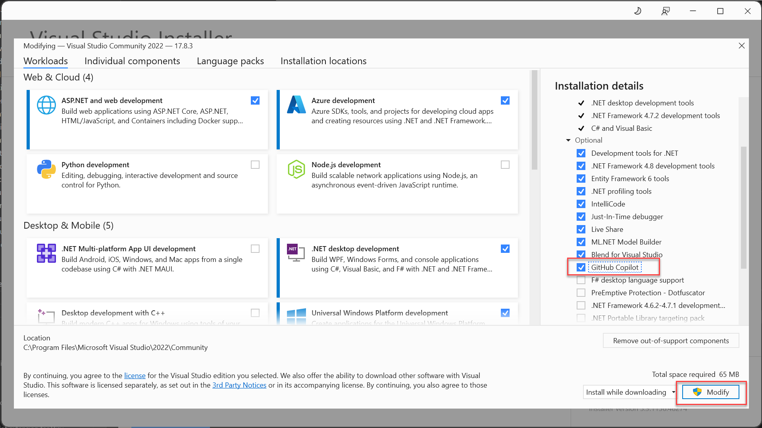
Notes:
You can install Github Copilot, using the Visual Studio installer and adding it as an optional.
It will add, both Github Copilot and Github Copilot Chat.

Slide 9

System: You are a friendly coding assistant…
User: Create a webserver in ASP.NET”
“Create a webserver in ASP.NET”
```csharp
var builder = WebApplication.CreateBuilder(args builder.Services.AddControllers(); …```
System: You are a friendly coding assistant…
User: Create a webserver in ASP.NET”
Assistant: Sure! Here’s a web..
Notes:
Lets’s say you make a request such as “create a webserver in typescript”, GitHub Copilot does a few things..
It enables you to make that request with some sort of user interface element – we’ll look at these different interaction models in a moment.
It takes your request and it adds to it something called a “system prompt”, as well as any context – other information or code that it thinks will be helpful in answering your question – and creates a prompt.
It identifies which GPT model to use – GPT 3.5 is fast, but 4.0 is accurate – so it tries to pick the right one based on the requested interaction.
It sends the request to the OpenAI model
It then parses the response from the model so that it can provide that code to you in the requested interaction format – either in chat in the editor or by adding code directly to your file.

Slide 10
sto·chas·tic​
Unpredictable
Notes:
Stochastic means unpredictable.
For instance, forecasting the weather is stochastic. You can have some confidence in the accuracy of the answer, but it will never be 100% every time.
LLM’s such as the ones that power GitHub Copilot are stochastic. You are going to get bad or inaccurate answers some of the time. This is strange for us as programmers because our entire profession is built around systems where the outcome is predictable and measurable. If I have a button in a form to add an item to a shopping cart, I can write a test to ensure that the item is in the shopping cart after the button is clicked. And I know that if it’s not, then my test has failed.
So what prompt engineering does is help us get the best answer the most amount of times.

Slide 11
Demo time!
Notes:
Let’s craft with Visual Studio, .NET 8, Blazor and Github Copilot.

Slide 12
Thank you.

